Slide 1
Bio-Mechanics Study of Human Arm.
Presented by: Atharv Nagvekar Group: ATRC [Student Intern]
Under the guidance of: Arvind Bansode [Sc-E]

Slide 2
Topic: Bio-Mechanics Study of Human Arm for deriving the characteristics of the actuator parameters based on human muscle capability and analysis & simulation of Bio-Mechanic Using available software.
Schedule for 6 months [June 26 – Jan 27]
Sr. No | Task | Methodology | Result | Timeline
1 | Bio-Mechanics Study of Human Arm | Study of present research work being carried out world wide | Detailed understanding Bio-Mechanics of Human Arm | Jun-Sep 26
2 | Bio-Mechanics Study of Human Arm for deriving the characteristics of the actuator parameters based on human muscle capability | Study of present research work being | Detailed report of the study and analysis | Oct-Nov 26
3 | Analysis & simulation of Bio-Mechanic Using available software | Simulations of different configurations | Comparison with standard literature actuator | Dec- Jan 27

Slide 3
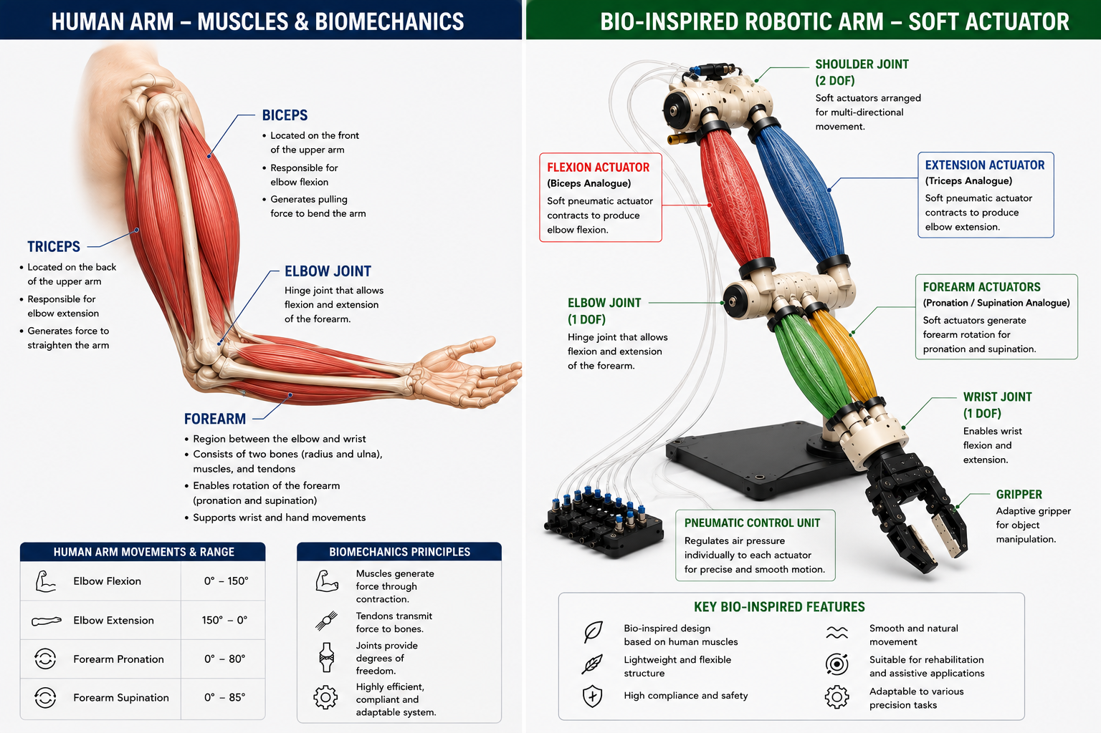
Objective:
To study the biomechanics and mechanical properties of the human arm muscles, derive actuator parameters based on human muscle capability, and analyse the biomechanical system using suitable simulation software
The human arm is a complex biomechanical system in which muscles generate force and motion through coordinated interaction with bones and joints.
The overall objective of the internship is to study the biomechanics of the human arm, understand the mechanical capability of human muscles, derive relevant actuator parameters, and finally perform analysis and simulation using available software.

Slide 4
Bones in Muscles involved in Human Arm are:
Major Bones
Humerus – Upper arm bone
Radius – Forearm bone on the thumb side
Ulna – Forearm bone on the little-finger side
Major Muscles
Biceps brachii
Brachialis
Brachioradialis
Triceps brachii
Anconeus
Pronator teres

Slide 5
Types of Motion Around the Elbow Joint:
The human arm performs four major movements involving the elbow and forearm:
Flexion
Bending of the forearm towards the upper arm, decreasing the angle at the elbow joint.
Extension
Straightening of the forearm, increasing the angle between the upper arm and forearm.
Pronation
Rotational movement of the forearm that turns the palm downward.
Supination
Rotational movement of the forearm that turns the palm upward.

Slide 6
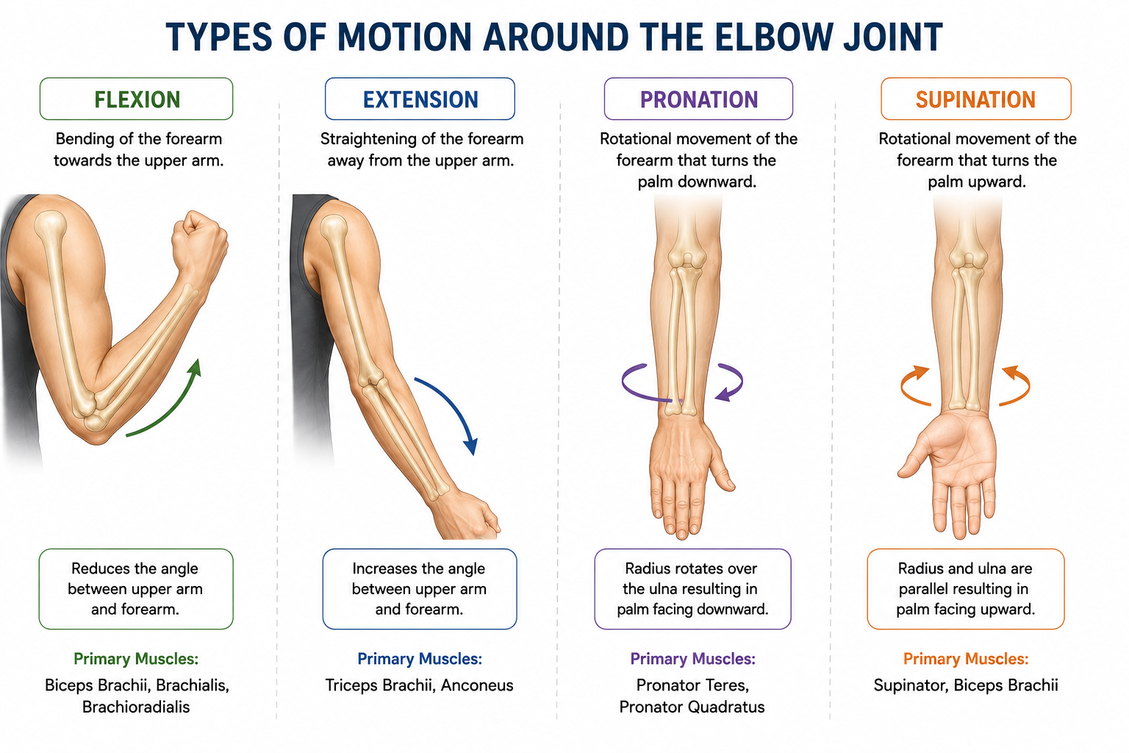

Slide 7
Mechanical Properties of Muscles:
1. Biceps Brachii

